Slide 1
Machine Learning Roadmap 2021
(a machine-learning-flavoured-visual-iterative-living-mind-map/compass)
- Ash

Slide 2
Artificial Learning
v/s
Machine Learning
v/s
Deep Learning
v/s
Data Science
Artificial Intelligence (AI)
Machine Learning (ML)
Data Science
Mathematics
Statistics
Visualization
EDA
Deep Learning (DL)

Slide 3
What is Machine Learning?
(It’s not some magic that computer does)
(It’s neither hard coded like CP)
(It will never be 100% accurate)

Slide 4
Machine Learning is turning things (data) into numbers and finding patterns in those numbers.
The computer does this part.
How???
Mathematics
(Don’t worry, we would cover a little on this later without making it crazy boring)

Slide 5
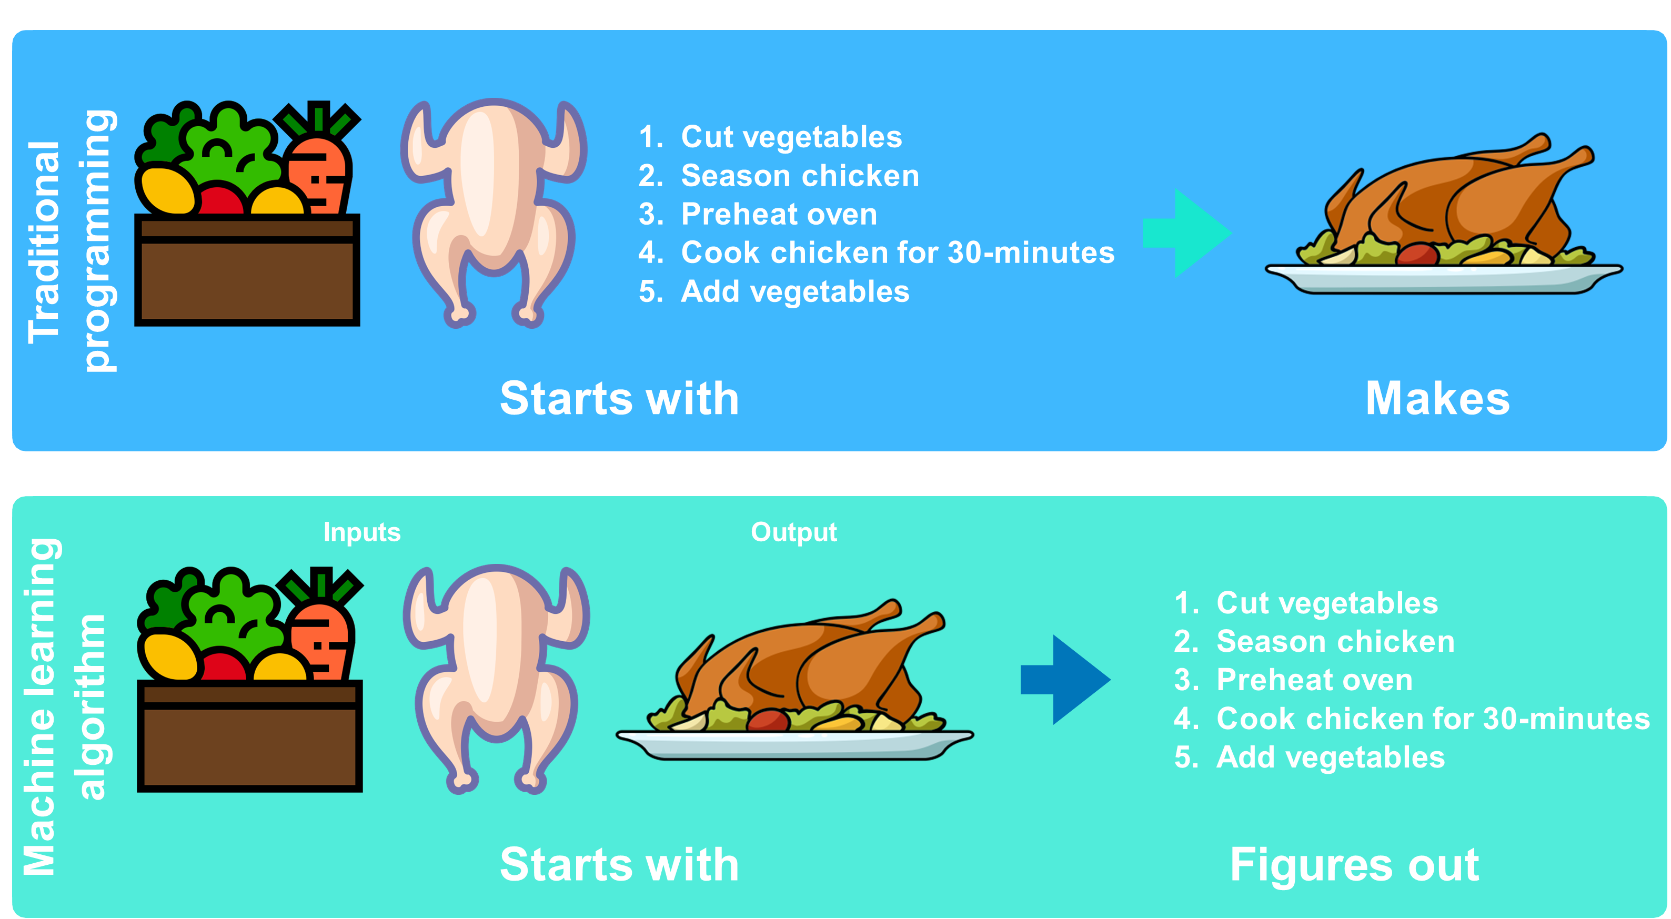

Slide 6
“Why use machine learning?”
Good reason: Why not?
Better reason: Can you think of all the rules?
(probably not)

Slide 7
If you can build a simple rule-based system that doesn’t require machine learning, do that.
(maybe not very simple)
A wise (lazy) software engineer would always choose the simplest algorithm to go with…..

Slide 8
What machine learning is good for….?
Problems with long lists of rules – when the traditional approach fails, machine learning may help.
Dynamic environments – machine learning can adapt (‘learn’) to new scenarios.
Discovering insights within large collection of data – can you imagine trying to go through every transaction OUTR has ever hand by hand….?

Slide 9
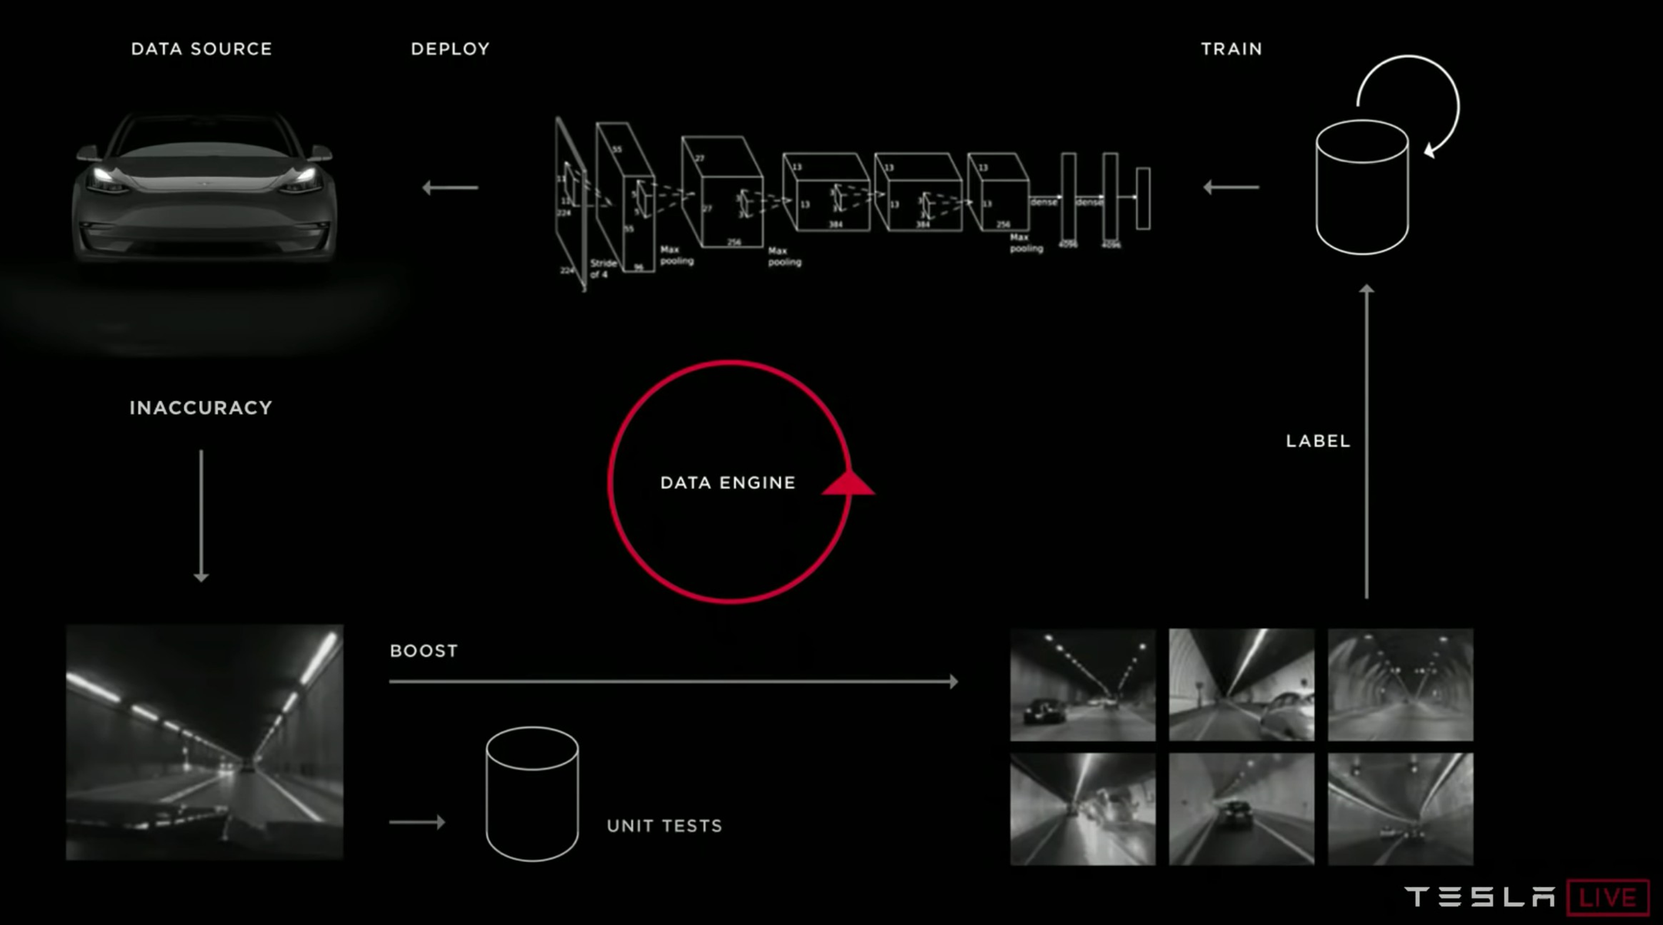
Problems with long lists of rules
Discovering insights within large collection od data
Dynamic environment

Slide 10
What we’re going to cover
(broadly)
Machine Learning Problems – what does a machine learning problem look like?
Machine Learning Process – once you’ve found a problem, what steps might you take to solve it?
Machine Learning Tools – what should you use to build your solution?
Machine Learning Mathematics – what exactly is happening under the hood?
Machine Learning Resources – okay, this is cool, how can I learn all of this?

Slide 11
Ready?
Okay, let’s go.

Slide 12
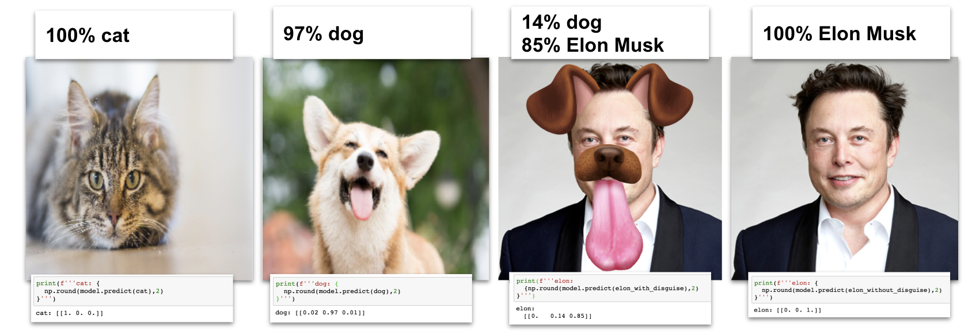
1. Machine Learning Problems

Slide 13


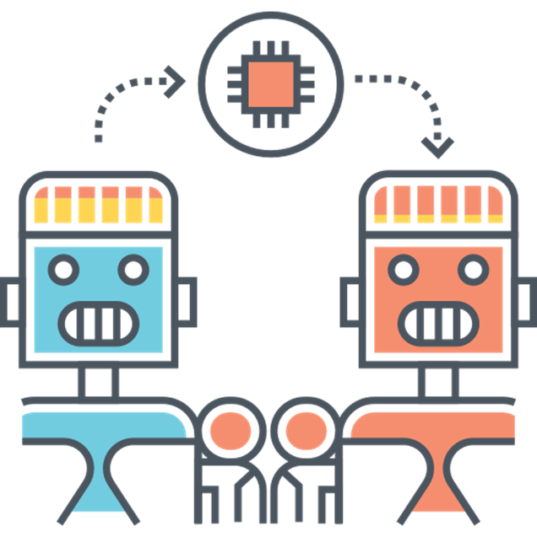
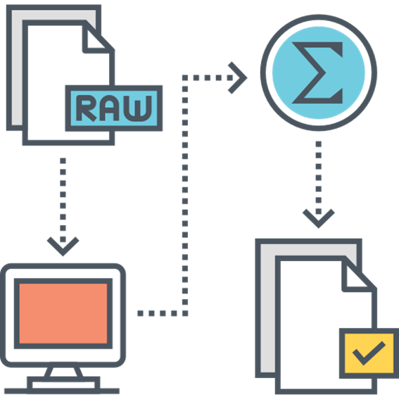
Categories of Learning
Supervised Learning
Unsupervised Learning
Transfer Learning
Reinforcement Learning

Slide 14


















Problem Domains
(dropped)
(most important)
ID | Weight | Heartrate | Age | Heart Disease?
0 | 76 | 54 | 55 | 0
1 | 81 | 42 | 34 | 0
2 | 90 | 70 | 47 | 0
3 | 67 | 100 | 79 | 1
Heart disease?
Classification
Regression
Clustering
Dimensionality Reduction

Slide 15
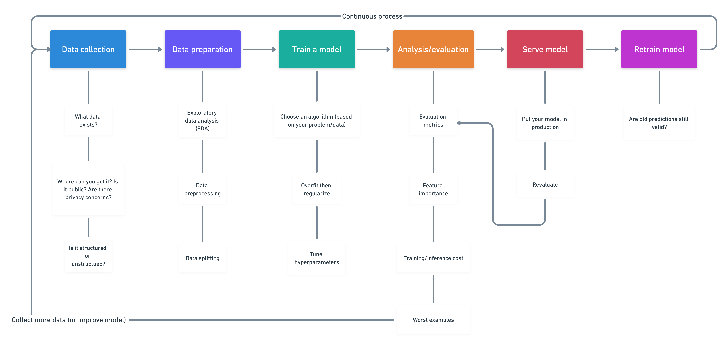
2. Machine Learning Process

Slide 16
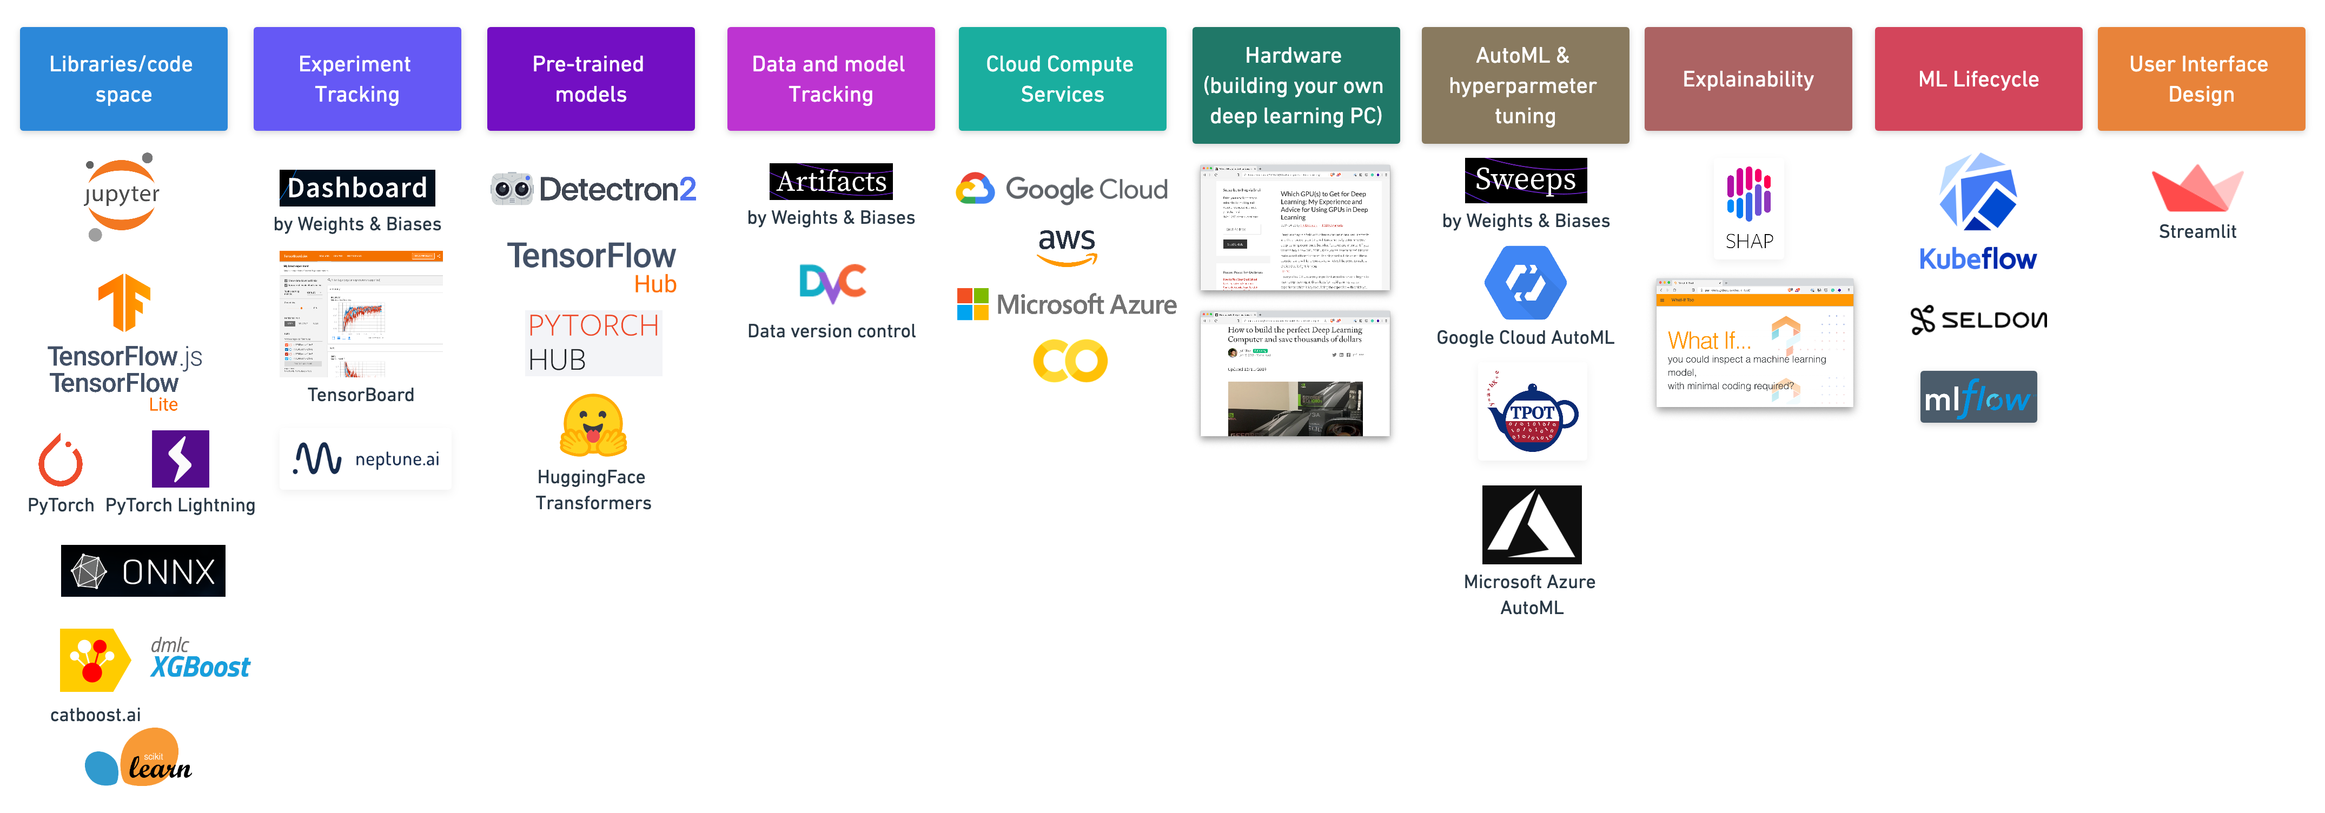
3. Machine Learning Tools

Slide 17
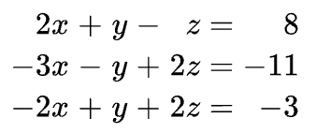
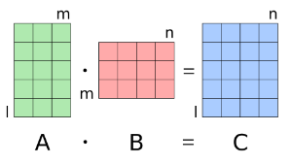
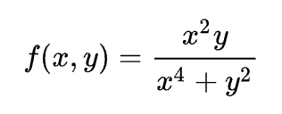
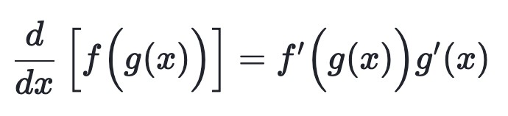
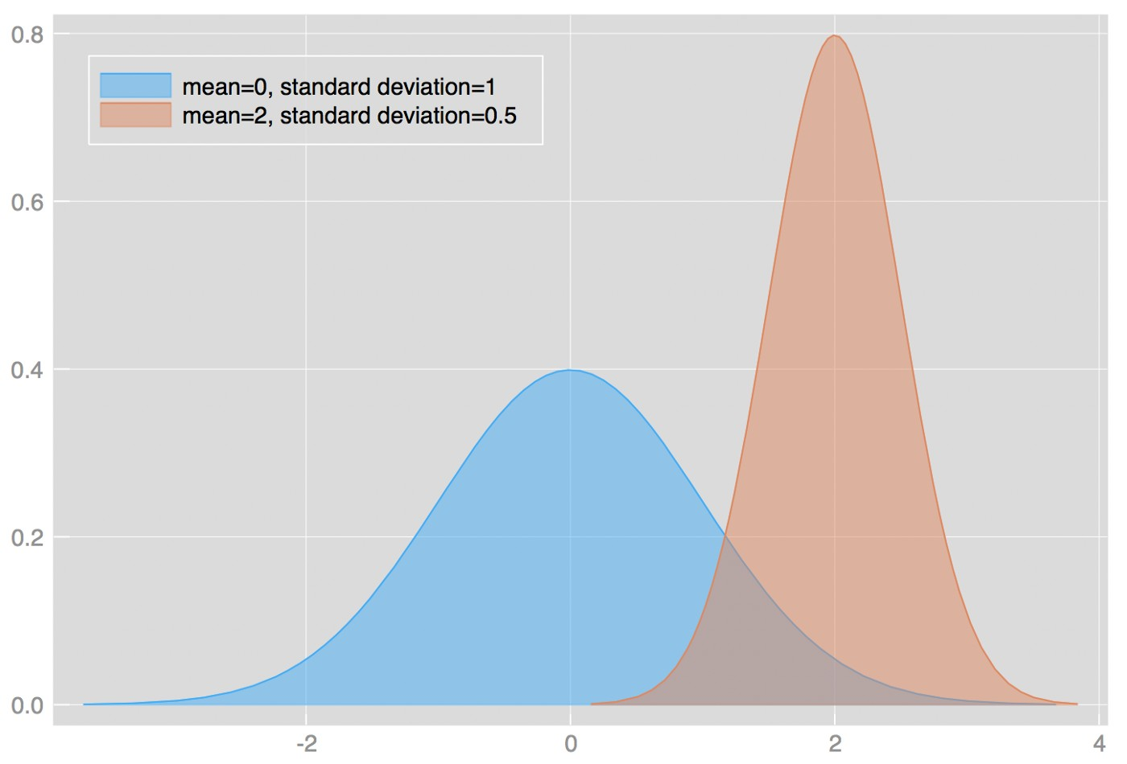
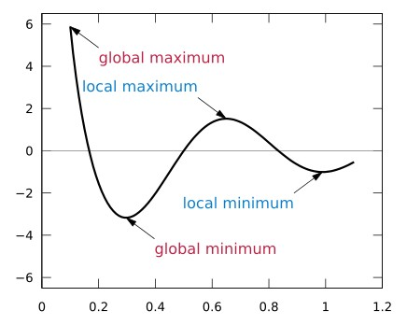
4. Machine Learning Mathematics
(some of the main ones)
Linear Algebra
Matrix Manipulation
Multivariate Calculus
The Chain Rule
Probability + Distributions
Optimization

Slide 18
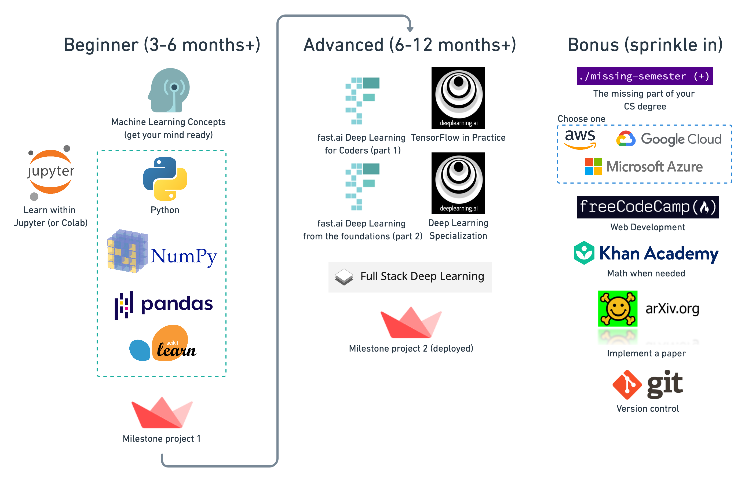
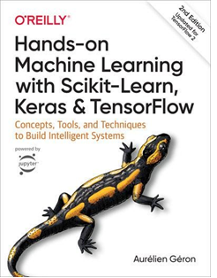
5. Machine Learning Resources
(where to start learning)

Slide 19







Starting Through……
Matplotlib to plot graphs and visualize figures and shapes
3 Stars in Python
NumPy for handling values and Pandas for handling DataFrames
Scikit Learn to use the built in algorithms for Classification, Regression, Clustering, Dimensionality reduction, Model selection, Preprocessing
Tensorflow 2.0 for building Neural Networks, Pre Processing Complex Data, and Result Analysis

Slide 20
Keep earning Keep creating
(machine)

Slide 21




Contact Info:
https://github.com/Ashindustry007
https://www.linkedin.com/in/ashishpanda007/
https://www.kaggle.com/ashishkumarpanda
https://wa.link/snuixy

